Slide 1
Phishing Attack Detection and Prevention Tool

Slide 2
Agenda
Introduction
Primary goals
Areas of growth
Timeline
Summary

Slide 3
Background and Introduction
Phishing is a common cyber attack where hackers send fake emails to steal personal info like passwords and credit card numbers.
Gmail is a major target due to its large number of users.
This project aims to build a simple tool that checks emails for phishing. It protects users by scanning emails and warning them about suspicious content.

Slide 4
Market Survey
Feature | Machine Learning Tools | Rule-Based Tools
Domain-Specific (.edu.pk) | ❌ Not designed for specific domains | ✅ focused on .edu.pk
Need for Training Data | ✅ Yes, needs large datasets | ❌ No training needed
Complexity | ❌ Hard to understand | ✅ Easy to follow
Performance | ✅ High detection accuracy | ✅ Good for known patterns
Update Requirements | ❌ Requires retraining | ✅ Easy to update CSV files
Examples | Gmail AI, Barracuda ML filters | Custom Python Tool for Gmail .edu.pk

Slide 5
Problem Statement
Most phishing filters are built for general use and often miss targeted attacks on educational domains like .edu.pk. These attacks commonly include fake scholarship offers, exam result scams, or password reset traps. Other tools are complex and difficult to manage for non-technical users in schools and universities.
There is a clear need for a simple, rule-based system that:
Matches senders, links, and keywords against trusted data
Is easy to update and maintain
Works best for academic institutions needing fast and clear email protection

Slide 6
Project Scope
This project is designed specifically for Gmail users, focusing on detecting phishing emails that are commonly sent to .edu.pk domains, which are widely used by schools, colleges, and universities in Pakistan.
These emails often carry targeted scams such as fake scholarship notifications, exam result frauds, and account verification traps aimed at students and academic staff.
The system is lightweight and easy to manage. It uses a rule-based approach that checks:
Sender addresses against a trusted whitelist
Links against a database of safe URLs
Email content for known phishing-related keywords

Slide 7
Proposed Solution
We created a tool that checks each incoming Gmail message using these steps:
Is the sender on the trusted list?
Are the links safe?
Are there phishing-related keywords?
If anything looks suspicious, the email is marked as spam (phishing).
Results are shown in a simple dashboard.

Slide 8
Requirement Summary
Hardware: Laptop/PC with internet.
Software: Python 3.x, VS Code or Jupyter Notebook.
Libraries: imaplib, email, pandas, re.
Email Access: IMAP protocol (with Gmail app password).
Data files used: trusted_senders.csv, trusted_links.csv, phishing_samples.csv.

Slide 9
Design Summary
Data Flow: Read emails → Load data → Match sender, links, and keywords → Mark email.
STRIDE Model used for threat analysis (Spoofing, Tampering, Info Disclosure, etc.).
Rule-Based Logic: Clear, simple steps to classify emails.

Slide 10
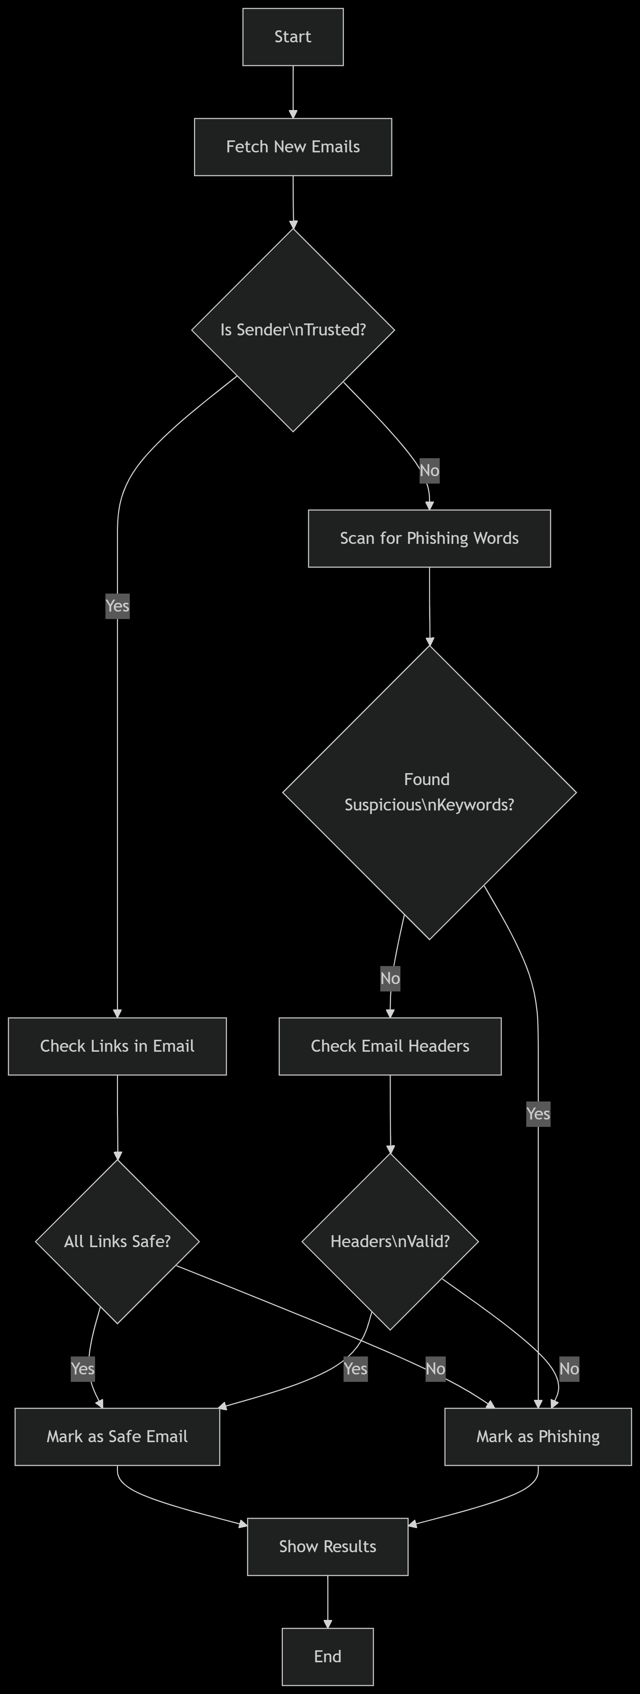
Design Summary

Slide 11
Methodology
System compares email with known phishing data and trusted lists.
Steps:
Load email.
Extract sender, links, and text.
Match with trusted data.
Mark as “ham” (safe) or “spam” (phishing).
Fully written in Python.

Slide 12
Implementation Summary
Emails are fetched using IMAP.
All detection logic is in one Python script.
Trusted senders, links, and phishing phrases are stored in .csv files.
Results are displayed in the terminal and Streamlit dashboard.
Code follows good practices (try-except, readable comments).

Slide 13
Experiments and Results Summary
We created sample emails to test different cases:
Trusted sender → Safe
Unknown sender with phishing link → Phishing Container
Keyword-only attack → Phishing Container
Results:
True Positive Rate: High (detected phishing correctly)
False Positive Rate: Low (did not wrongly flag safe emails)

Slide 14
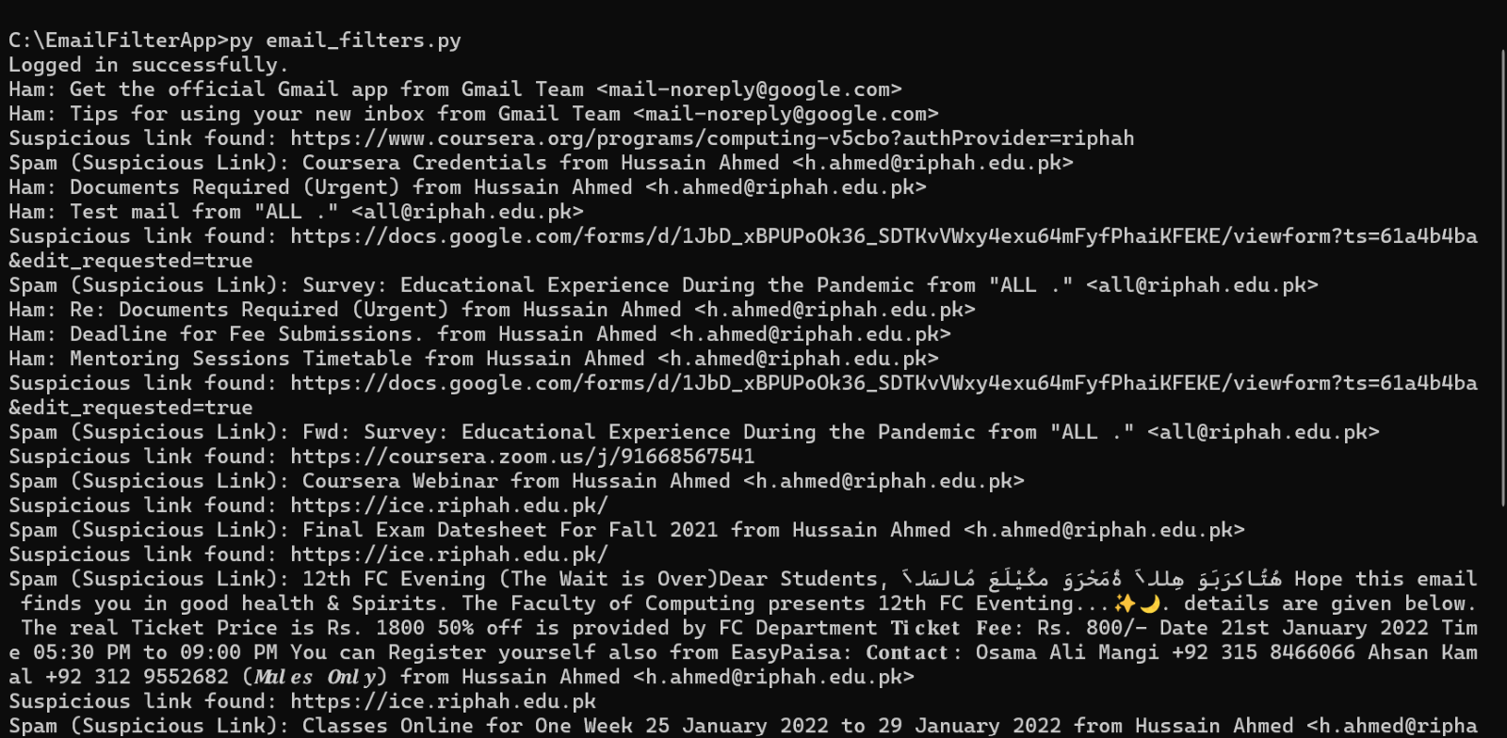
Experiments and Results Summary

Slide 15
Testing Summary
We tested emails with known phishing keywords and fake links.
All test cases were passed.
Penetration testing (optional): Sent fake phishing emails from test accounts.
System detected them successfully.

Slide 16
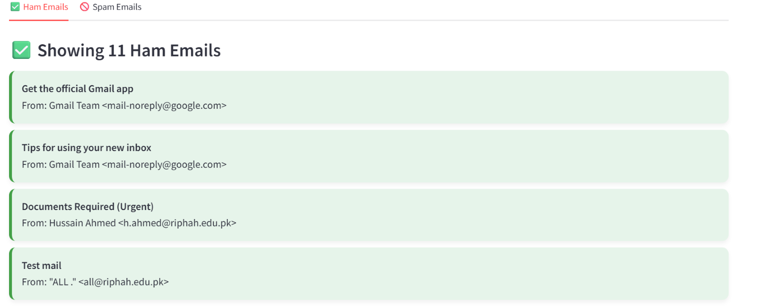
Testing Summary

Slide 17
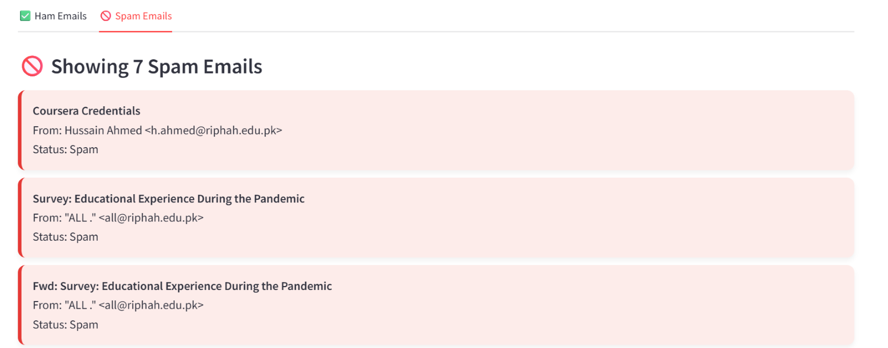
Testing Summary

Slide 18
Conclusion and Outlook
The project successfully built a simple, effective tool for Gmail phishing detection. Easy to use, maintain, and update.
Future work:
The tool can be improved further by integrating it with online services like VirusTotal or other malware scanners to validate suspicious links and attachments. It can also be enhanced to take countermeasures such as blocking known phishing sources or auto-quarantining emails.

Slide 19
Summary
At Contoso, we believe in giving 110%. By using our next-generation data architecture, we help organisations virtually manage agile workflows. We thrive because of our market knowledge and great team behind our product. As our CEO says, "Efficiencies will come from proactively transforming how we do business."

Slide 20
Thank you
Mirjam Nilsson​
mirjam@contoso.com
www.contoso.com

